Slide 1
Chapter 4
Carbon and the Molecular Diversity of Life

Slide 2
Overview: Carbon: The Backbone of Life
Although cells are 70–95% water, the rest consists mostly of carbon-based compounds
Carbon is unparalleled in its ability to form large, complex, and diverse molecules
Proteins, DNA, carbohydrates, and other molecules that distinguish living matter are all composed of carbon compounds
Copyright © 2008 Pearson Education, Inc., publishing as Pearson Benjamin Cummings

Slide 3
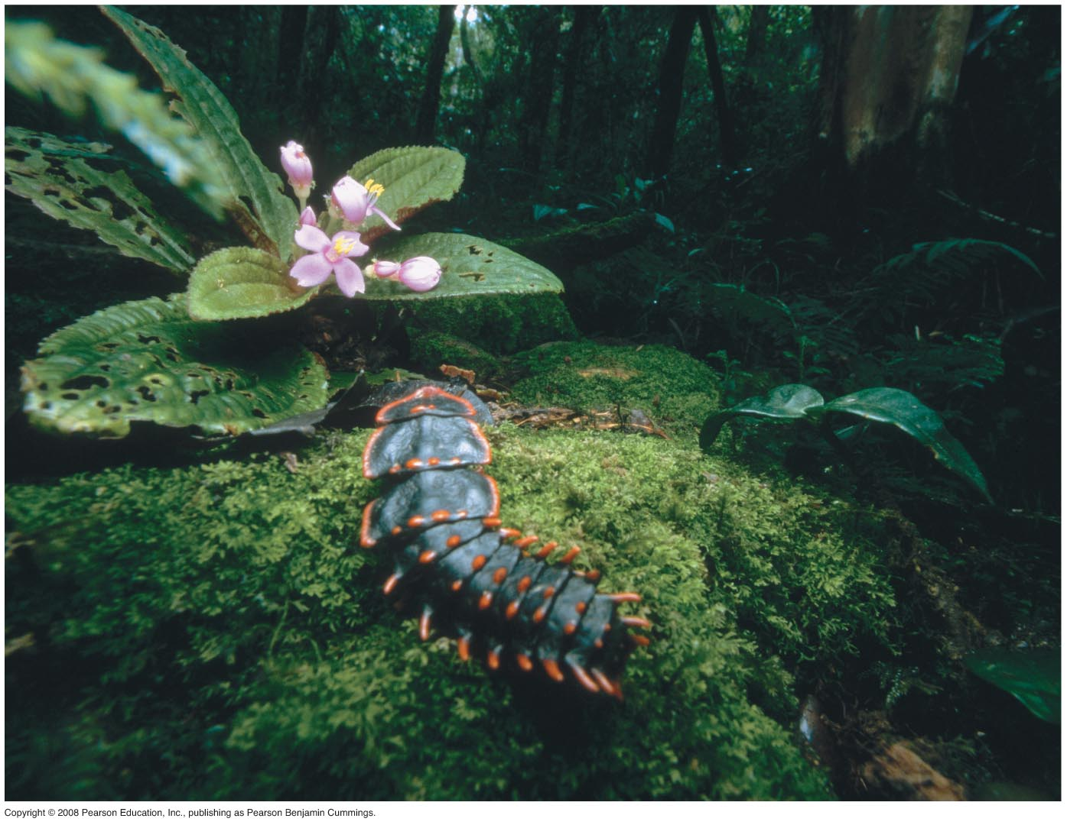
Fig. 4-1
Notes:
Figure 4.1 What properties of carbon underlie its role as the molecular basis of life?

Slide 4
Concept 4.1: Organic chemistry is the study of carbon compounds
Organic chemistry is the study of compounds that contain carbon
Organic compounds range from simple molecules to colossal ones
Most organic compounds contain hydrogen atoms in addition to carbon atoms
Copyright © 2008 Pearson Education, Inc., publishing as Pearson Benjamin Cummings

Slide 5
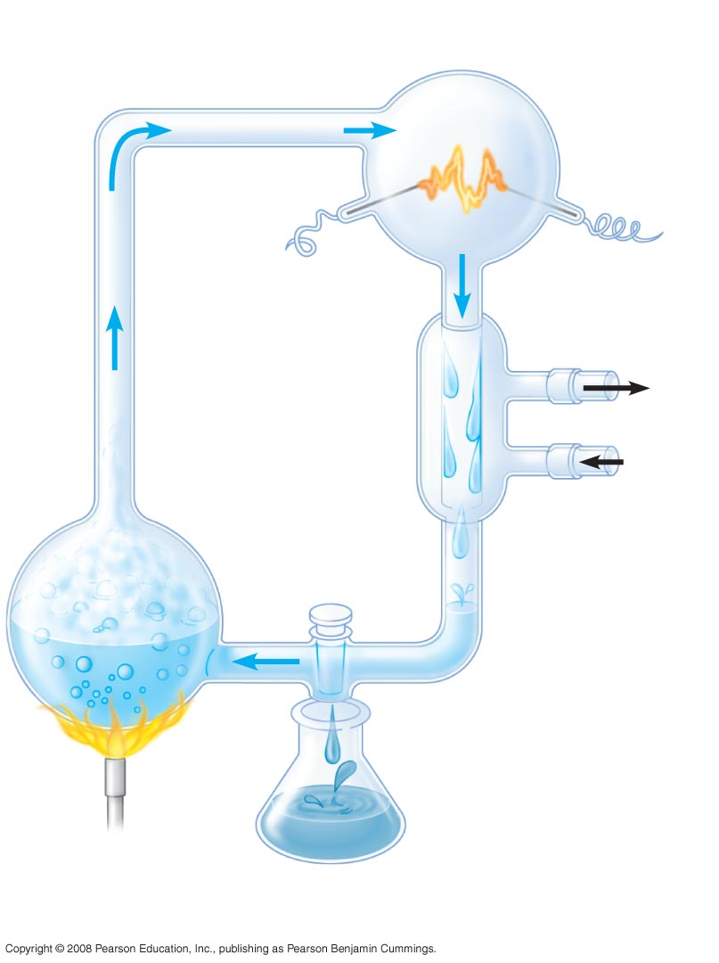
Fig. 4-2
EXPERIMENT
“Atmosphere”
CH₄
Water vapor
Electrode
NH₃
H₂
Condenser
Cooled water
containing
organic
molecules
Cold
water
H₂O
“sea”
Sample for
chemical analysis
Notes:
Figure 4.2 Can organic molecules form under conditions believed to simulate those on the early Earth?

Slide 6
Concept 4.2: Carbon atoms can form diverse molecules by bonding to four other atoms
Electron configuration is the key to an atom’s characteristics
Electron configuration determines the kinds and number of bonds an atom will form with other atoms
Copyright © 2008 Pearson Education, Inc., publishing as Pearson Benjamin Cummings

Slide 7
The Formation of Bonds with Carbon
With four valence electrons, carbon can form four covalent bonds with a variety of atoms
This tetravalence makes large, complex molecules possible
In molecules with multiple carbons, each carbon bonded to four other atoms has a tetrahedral shape
However, when two carbon atoms are joined by a double bond, the molecule has a flat shape
Copyright © 2008 Pearson Education, Inc., publishing as Pearson Benjamin Cummings

Slide 8
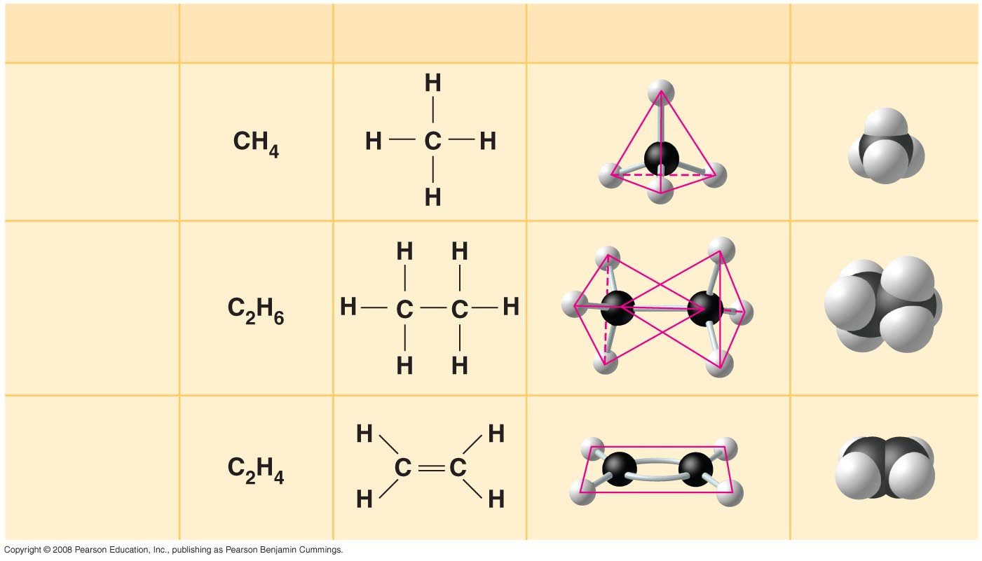
Fig. 4-3
Molecular Formula
Structural Formula
Ball-and-Stick
Model
Space-Filling
Model
Name
(a) Methane
(b) Ethane
(c) Ethene
(ethylene)
Notes:
Figure 4.3 The shapes of three simple organic molecules

Slide 9
The electron configuration of carbon gives it covalent compatibility with many different elements
The valences of carbon and its most frequent partners (hydrogen, oxygen, and nitrogen) are the “building code” that governs the architecture of living molecules
Copyright © 2008 Pearson Education, Inc., publishing as Pearson Benjamin Cummings

Slide 10
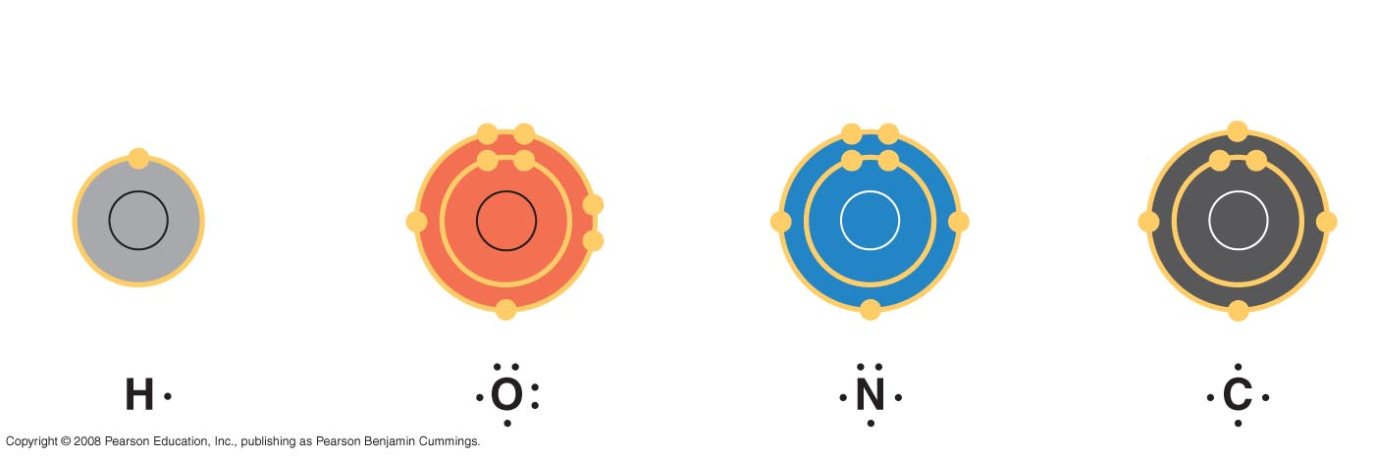
Fig. 4-4
Hydrogen
(valence = 1)
Oxygen
(valence = 2)
Nitrogen
(valence = 3)
Carbon
(valence = 4)
H
O
N
C
Notes:
Figure 4.4 Valences of the major elements of organic molecules

Slide 11
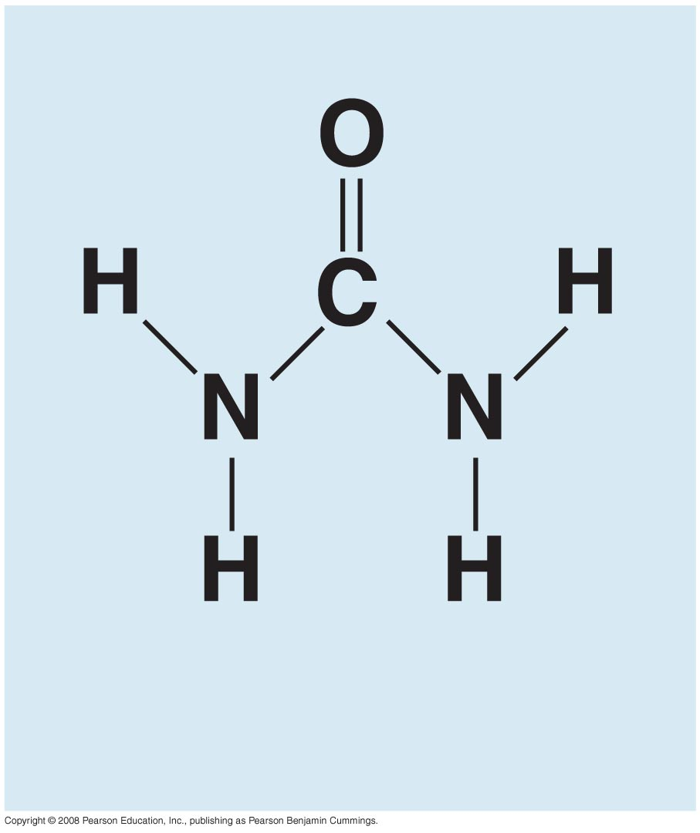
Fig. 4-UN1
Urea

Slide 12

Molecular Diversity Arising from Carbon Skeleton Variation
Carbon chains form the skeletons of most organic molecules
Carbon chains vary in length and shape
Animation: Carbon Skeletons
Copyright © 2008 Pearson Education, Inc., publishing as Pearson Benjamin Cummings

Slide 13
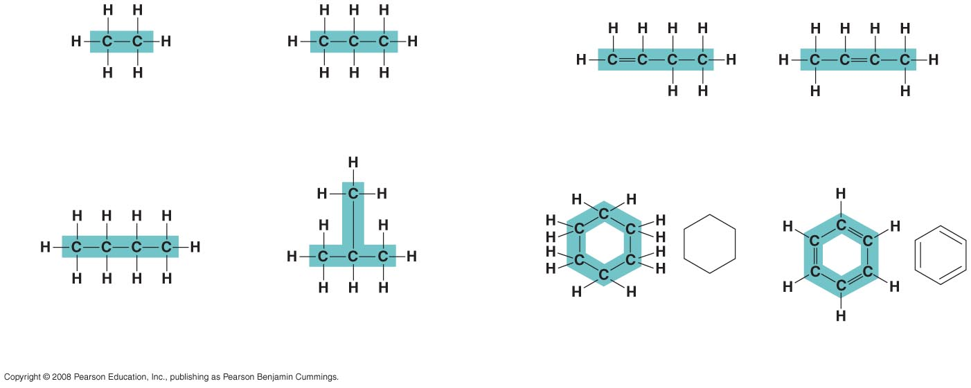
Fig. 4-5
Ethane
Propane
1-Butene
2-Butene
(a) Length
(c) Double bonds
Butane
2-Methylpropane
(commonly called isobutane)
Cyclohexane
Benzene
(b) Branching
(d) Rings
Notes:
Figure 4.5 Variation in carbon skeletons

Slide 14
Hydrocarbons
Hydrocarbons are organic molecules consisting of only carbon and hydrogen
Many organic molecules, such as fats, have hydrocarbon components
Hydrocarbons can undergo reactions that release a large amount of energy
Copyright © 2008 Pearson Education, Inc., publishing as Pearson Benjamin Cummings

Slide 15
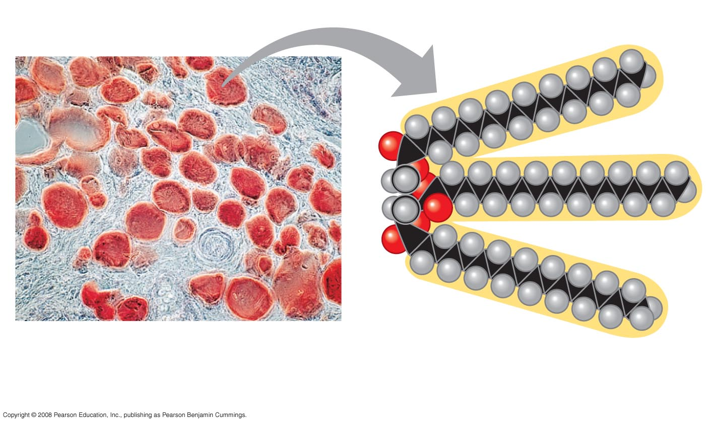
Fig. 4-6
Fat droplets (stained red)
100 µm
(a) Mammalian adipose cells
(b) A fat molecule
Notes:
Figure 4.6 The role of hydrocarbons in fats

Slide 16
Isomers
Isomers are compounds with the same molecular formula but different structures and properties:
  Structural isomers have different covalent arrangements of their atoms
  Geometric isomers have the same covalent arrangements but differ in spatial arrangements
  Enantiomers are isomers that are mirror images of each other
Animation: Isomers
Copyright © 2008 Pearson Education, Inc., publishing as Pearson Benjamin Cummings

Slide 17
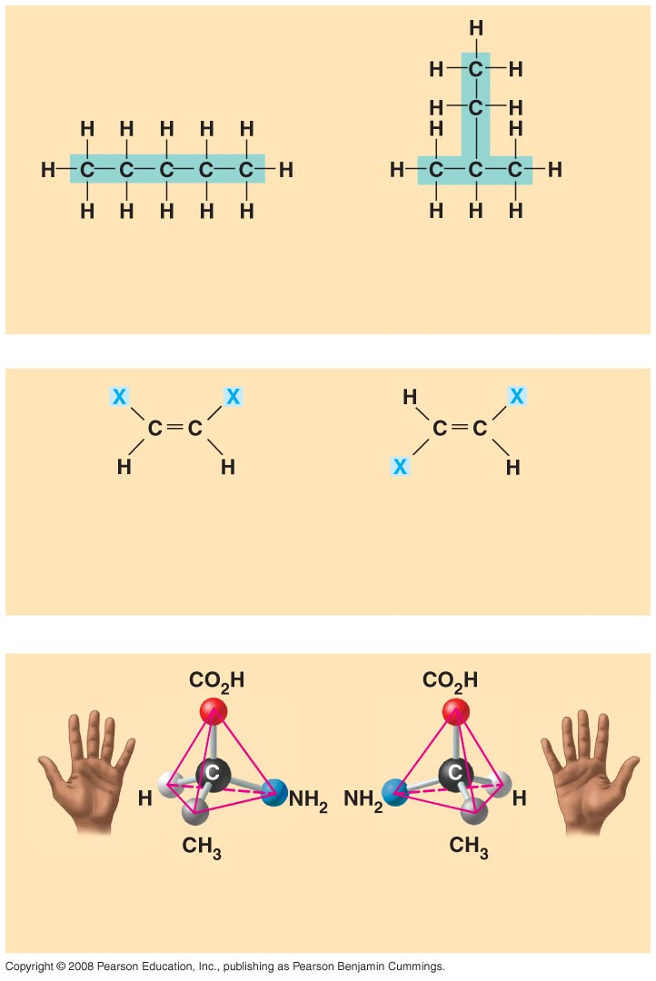
Fig. 4-7
Pentane
2-methyl butane
(a) Structural isomers
cis isomer: The two Xs are
on the same side.
trans isomer: The two Xs are
on opposite sides.
(b) Geometric isomers
L isomer
D isomer
(c) Enantiomers
Notes:
Figure 4.7 Three types of isomers

Slide 18
Enantiomers are important in the pharmaceutical industry
Two enantiomers of a drug may have different effects
Differing effects of enantiomers demonstrate that organisms are sensitive to even subtle variations in molecules
Animation: L-Dopa
Copyright © 2008 Pearson Education, Inc., publishing as Pearson Benjamin Cummings

Slide 19
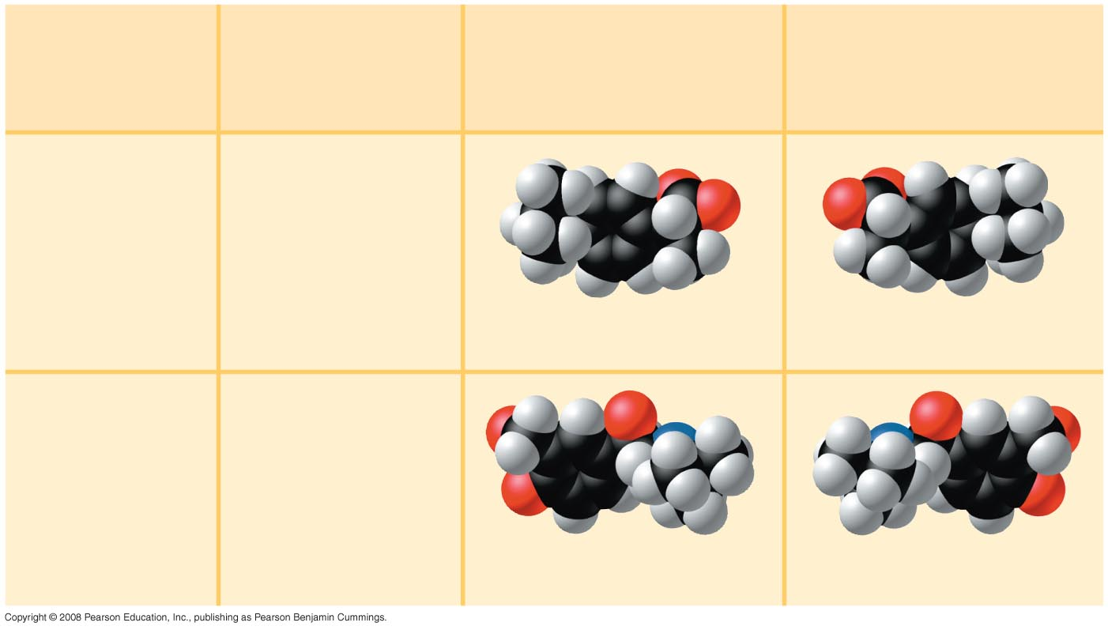
Fig. 4-8
Effective
Enantiomer
Ineffective
Enantiomer
Drug
Condition
Ibuprofen
Pain;
inflammation
S-Ibuprofen
R-Ibuprofen
Albuterol
Asthma
R-Albuterol
S-Albuterol
Notes:
Figure 4.8 The pharmacological importance of enantiomers

Slide 20
Concept 4.3: A small number of chemical groups are key to the functioning of biological molecules
Distinctive properties of organic molecules depend not only on the carbon skeleton but also on the molecular components attached to it
A number of characteristic groups are often attached to skeletons of organic molecules
Copyright © 2008 Pearson Education, Inc., publishing as Pearson Benjamin Cummings

Slide 21
The Chemical Groups Most Important in the Processes of Life
Functional groups are the components of organic molecules that are most commonly involved in chemical reactions
The number and arrangement of functional groups give each molecule its unique properties
Copyright © 2008 Pearson Education, Inc., publishing as Pearson Benjamin Cummings

Slide 22
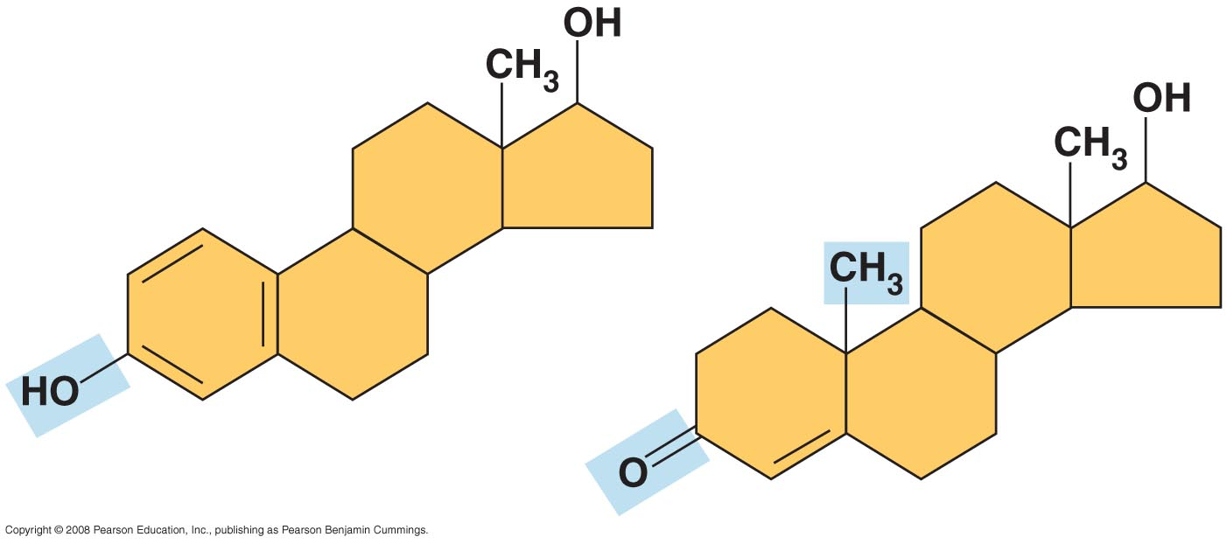
Fig. 4-9
Estradiol
Testosterone
Notes:
Figure 4.9 A comparison of chemical groups of female (estradiol) and male (testosterone) sex hormones

Slide 23
The seven functional groups that are most important in the chemistry of life:
  Hydroxyl group
  Carbonyl group
  Carboxyl group
  Amino group
  Sulfhydryl group
  Phosphate group
  Methyl group
Copyright © 2008 Pearson Education, Inc., publishing as Pearson Benjamin Cummings

Slide 24
FUN WITH FUNCTIONAL GROUPS!
It is useful to be familiar with the functional groups as they so often appear in biological molecules. Rather than memorize them, let’s have them readily available for reference.
Each of you will do TWO mini posters of two different functional groups. On the page will be NEAT and CLEAR facts. I will hang the top 7 in the room for us to refer to all year..
On each poster will be the following……
  The group name
  Large sketch of structural formula
  Simplified functional properties (see me if unsure)

Slide 25
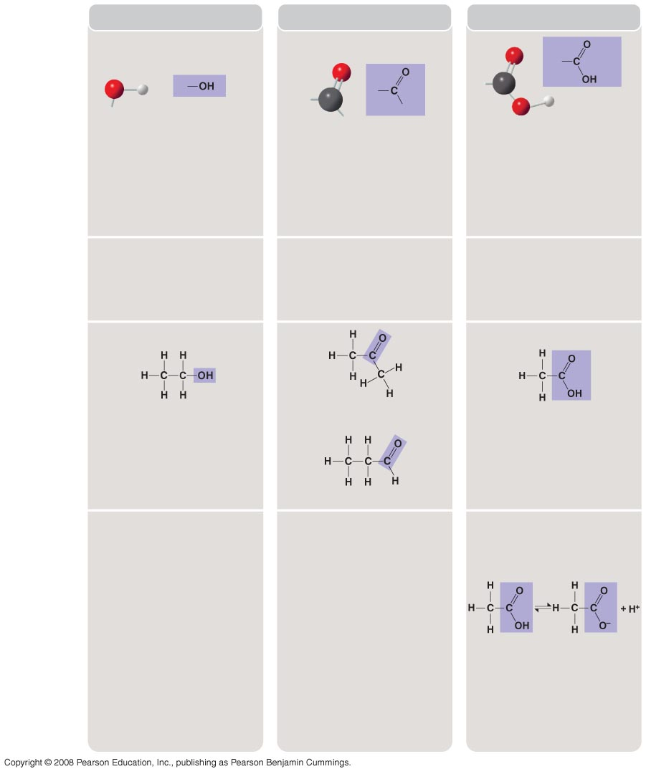
Fig. 4-10a
CHEMICAL
GROUP
Hydroxyl
Carbonyl
Carboxyl
STRUCTURE
(may be written HO—)
In a hydroxyl group (—OH), a
hydrogen atom is bonded to an
oxygen atom, which in turn is
bonded to the carbon skeleton of
the organic molecule. (Do not
confuse this functional group
with the hydroxide ion, OH–.)
The carbonyl group ( CO)
consists of a carbon atom
joined to an oxygen atom by a
double bond.
When an oxygen atom is
double-bonded to a carbon
atom that is also bonded to
an —OH group, the entire
assembly of atoms is called
a carboxyl group (—COOH).
NAME OF COMPOUND
Alcohols (their specific names
usually end in -ol)
Ketones if the carbonyl group is
within a carbon skeleton
Carboxylic acids, or organic
acids
Aldehydes if the carbonyl group
is at the end of the carbon
skeleton
EXAMPLE
Ethanol, the alcohol present in
alcoholic beverages
Acetone, the simplest ketone
Acetic acid, which gives vinegar
its sour taste
Propanal, an aldehyde
FUNCTIONAL
PROPERTIES
Is polar as a result of the
electrons spending more time
near the electronegative
oxygen atom.
A ketone and an aldehyde may
be structural isomers with
different properties, as is the
case for acetone and propanal.
Has acidic properties
because the covalent bond
between oxygen and hydrogen
is so polar; for example,
Can form hydrogen bonds with
water molecules, helping
dissolve organic compounds
such as sugars.
These two groups are also
found in sugars, giving rise to
two major groups of sugars:
aldoses (containing an
aldehyde) and ketoses
(containing a ketone).
Acetic acid
Acetate ion
Found in cells in the ionized
form with a charge of 1– and
called a carboxylate ion (here,
specifically, the acetate ion).
Notes:
Figure 4.10 Some biologically important chemical groups

Slide 26
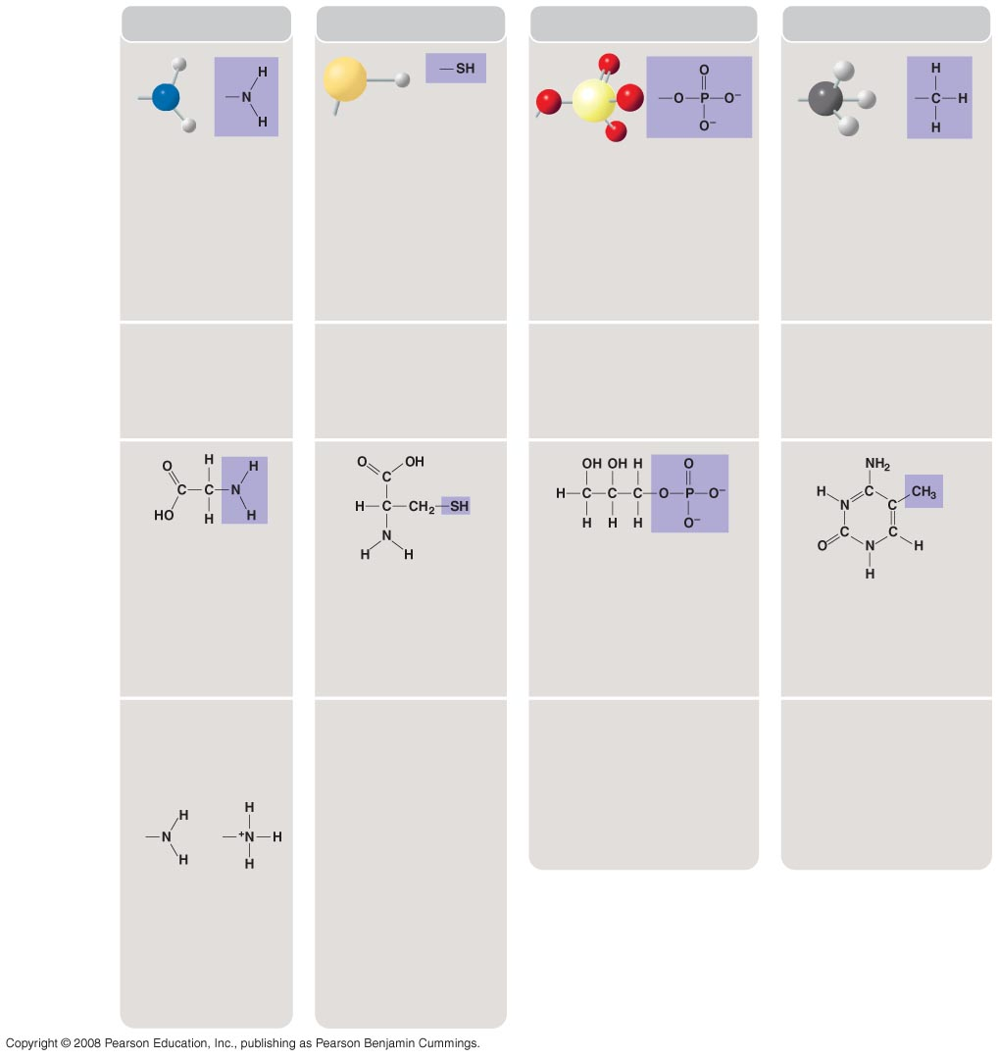
Fig. 4-10b
CHEMICAL
GROUP
Amino
Sulfhydryl
Phosphate
Methyl
STRUCTURE
(may be
written HS—)
The amino group
(—NH₂) consists of a
nitrogen atom bonded
to two hydrogen atoms
and to the carbon skeleton.
The sulfhydryl group
consists of a sulfur atom
bonded to an atom of
hydrogen; resembles a
hydroxyl group in shape.
In a phosphate group, a
phosphorus atom is bonded to
four oxygen atoms; one oxygen
is bonded to the carbon skeleton;
two oxygens carry negative
charges. The phosphate group
(—OPO₃^{2–}, abbreviated ) is an
ionized form of a phosphoric acid
group (—OPO₃H²; note the two
hydrogens).
A methyl group consists of a
carbon bonded to three
hydrogen atoms. The methyl
group may be attached to a
carbon or to a different atom.
P
NAME OF
COMPOUND
Amines
Thiols
Organic phosphates
Methylated compounds
EXAMPLE
Glycine
Glycerol phosphate
Because it also has a
carboxyl group, glycine
is both an amine and
a carboxylic acid;
compounds with both
groups are called
amino acids.
Cysteine
In addition to taking part in
many important chemical
reactions in cells, glycerol
phosphate provides the
backbone for phospholipids,
the most prevalent molecules in
cell membranes.
5-Methyl cytidine
Cysteine is an important
sulfur-containing amino
acid.
5-Methyl cytidine is a
component of DNA that has
been modified by addition of
the methyl group.
FUNCTIONAL
PROPERTIES
Acts as a base; can
pick up an H⁺ from
the surrounding
solution (water, in
living organisms).
Two sulfhydryl groups
can react, forming a
covalent bond. This
“cross-linking” helps
stabilize protein
structure.
Contributes negative charge
to the molecule of which it is
a part (2– when at the end of
a molecule; 1– when located
internally in a chain of
phosphates).
Addition of a methyl group
to DNA, or to molecules
bound to DNA, affects
expression of genes.
Arrangement of methyl
groups in male and female
sex hormones affects
their shape and function.
Cross-linking of
cysteines in hair
proteins maintains the
curliness or straightness
of hair. Straight hair can
be “permanently” curled
by shaping it around
curlers, then breaking
and re-forming the
cross-linking bonds.
Has the potential to react
with water, releasing energy.
(nonionized)
(ionized)
Ionized, with a
charge of 1+, under
cellular conditions.
Notes:
Figure 4.10 Some biologically important chemical groups

Slide 27
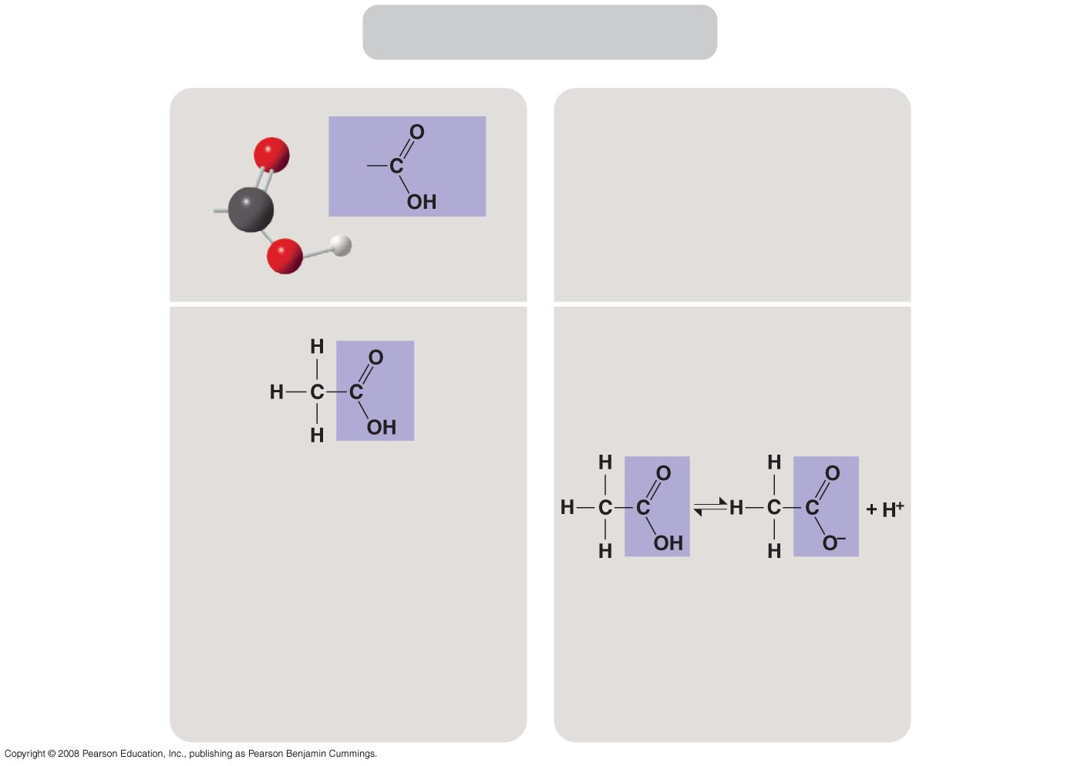
Fig. 4-10c
Carboxyl
STRUCTURE
NAME OF
COMPOUND
Carboxylic acids, or organic acids
EXAMPLE
Has acidic properties
because the covalent bond between oxygen and hydrogen is so polar; for example,
FUNCTIONAL
PROPERTIES
Acetic acid, which gives vinegar its sour taste
Acetic acid
Acetate ion
Found in cells in the ionized form with a charge of 1– and called a carboxylate ion (here, specifically, the acetate ion).
Notes:
Figure 4.10 Some biologically important chemical groups—carbonyl group

Slide 28
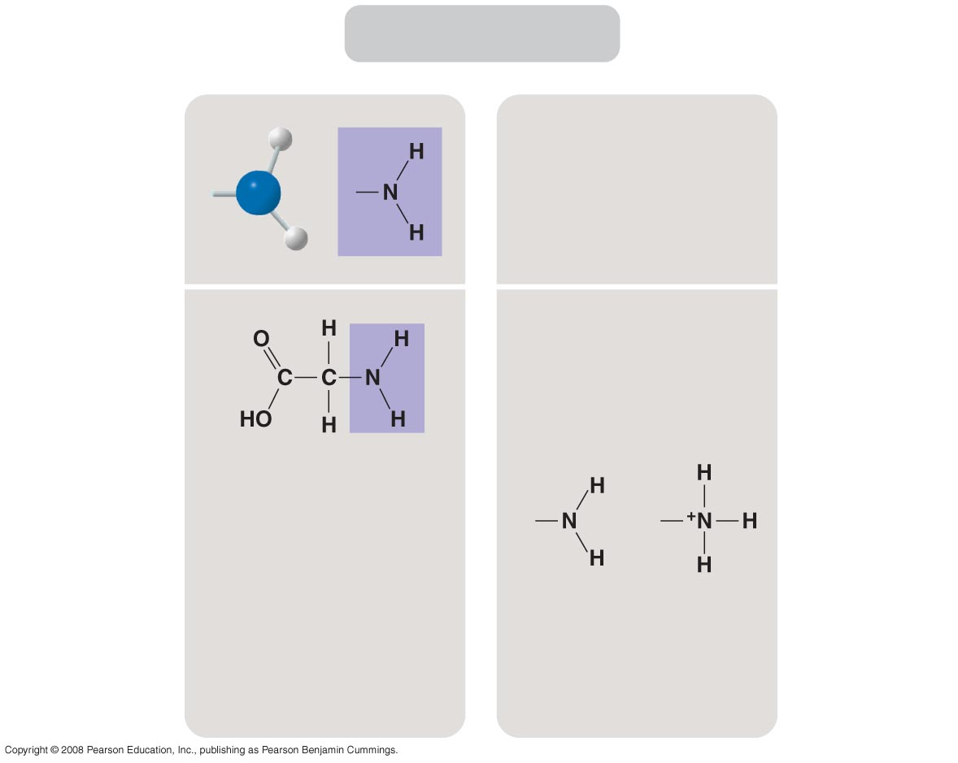
Fig. 4-10d
Amino
STRUCTURE
Amines
NAME OF
COMPOUND
EXAMPLE
FUNCTIONAL
PROPERTIES
Acts as a base; can pick up an H⁺ from the surrounding solution (water, in living organisms).
Glycine
Because it also has a carboxyl group, glycine is both an amine and
a carboxylic acid; compounds with both groups are called amino acids.
(nonionized)
(ionized)
Ionized, with a charge of 1+, under cellular conditions.
Notes:
Figure 4.10 Some biologically important chemical groups—amino group

Slide 29
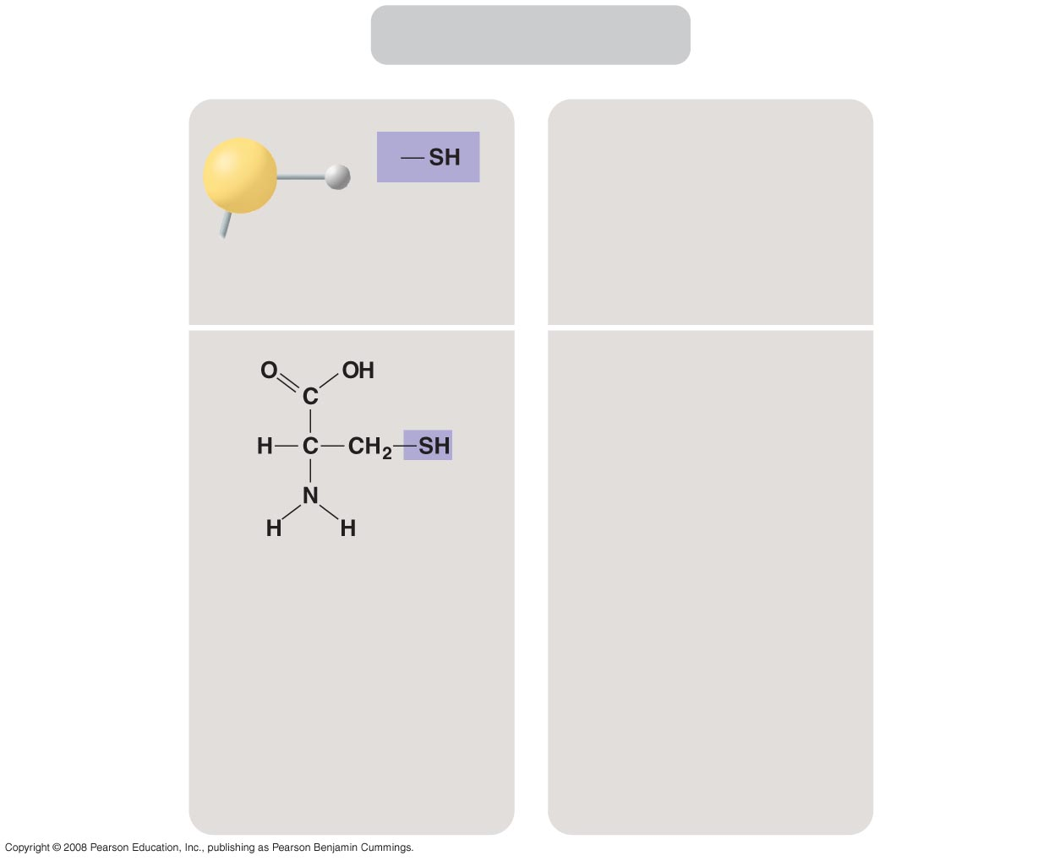
Fig. 4-10e
Sulfhydryl
STRUCTURE
NAME OF
COMPOUND
Thiols
(may be written HS—)
EXAMPLE
Two sulfhydryl groups can react, forming a covalent bond. This “cross-linking” helps stabilize protein structure.
FUNCTIONAL
PROPERTIES
Cysteine
Cross-linking of
cysteines in hair
proteins maintains the curliness or straightness of hair. Straight hair can be “permanently” curled by shaping it around curlers, then breaking
and re-forming the
cross-linking bonds.
Cysteine is an important sulfur-containing amino acid.
Notes:
Figure 4.10 Some biologically important chemical groups—sulfhydryl group

Slide 30
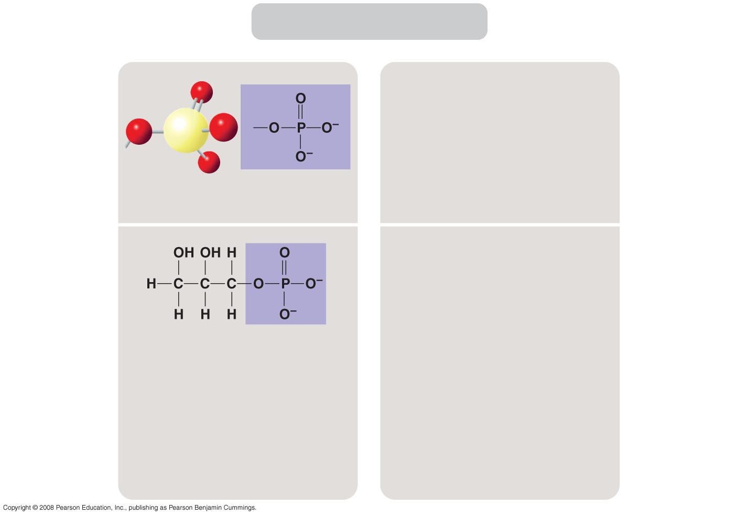
Fig. 4-10f
Phosphate
STRUCTURE
NAME OF
COMPOUND
Organic phosphates
EXAMPLE
FUNCTIONAL
PROPERTIES
Contributes negative charge to the molecule of which it is a part (2– when at the end of a molecule; 1– when located internally in a chain of phosphates).
Glycerol phosphate
Has the potential to react with water, releasing energy.
In addition to taking part in many important chemical reactions in cells, glycerol phosphate provides the backbone for phospholipids, the most prevalent molecules in cell membranes.
Notes:
Figure 4.10 Some biologically important chemical groups—phosphate group

Slide 31
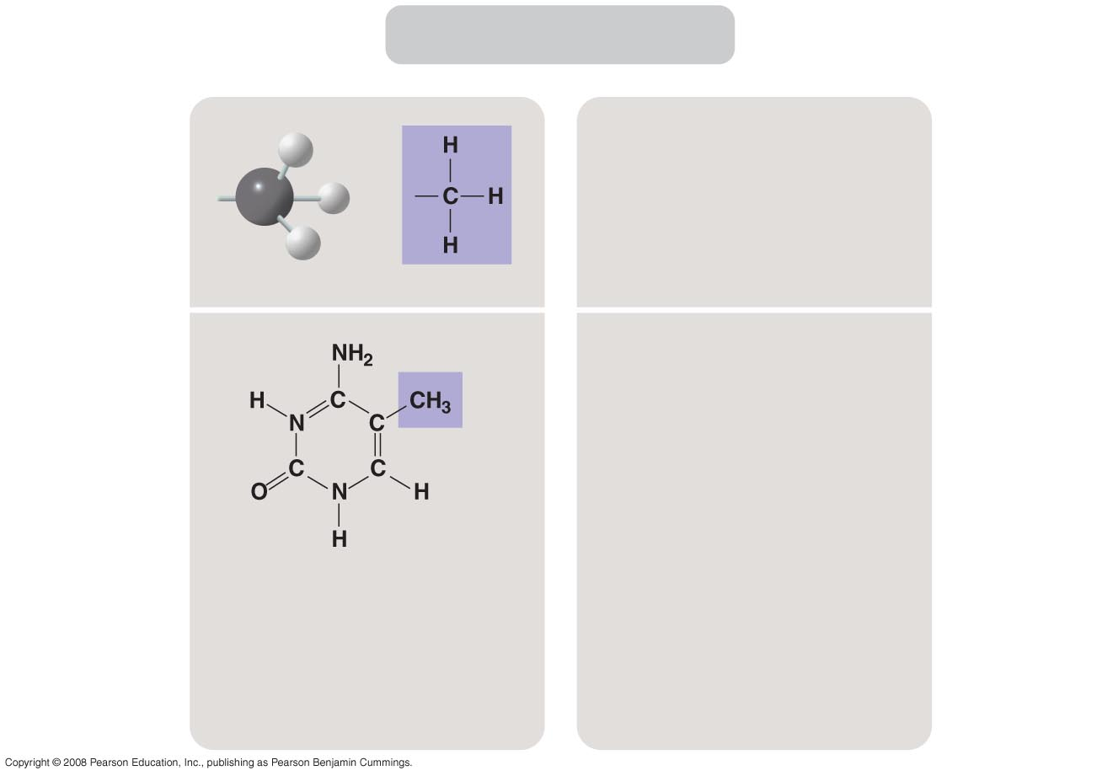
Fig. 4-10g
Methyl
STRUCTURE
NAME OF
COMPOUND
Methylated compounds
EXAMPLE
Addition of a methyl group to DNA, or to molecules bound to DNA, affects expression of genes.
FUNCTIONAL
PROPERTIES
Arrangement of methyl groups in male and female sex hormones affects
their shape and function.
5-Methyl cytidine
5-Methyl cytidine is a component of DNA that has been modified by addition of the methyl group.
Notes:
Figure 4.10 Some biologically important chemical groups—methyl group

Slide 32
ATP: An Important Source of Energy for Cellular Processes
One phosphate molecule, adenosine triphosphate (ATP), is the primary energy-transferring molecule in the cell
ATP consists of an organic molecule called adenosine attached to a string of three phosphate groups
Copyright © 2008 Pearson Education, Inc., publishing as Pearson Benjamin Cummings

Slide 33
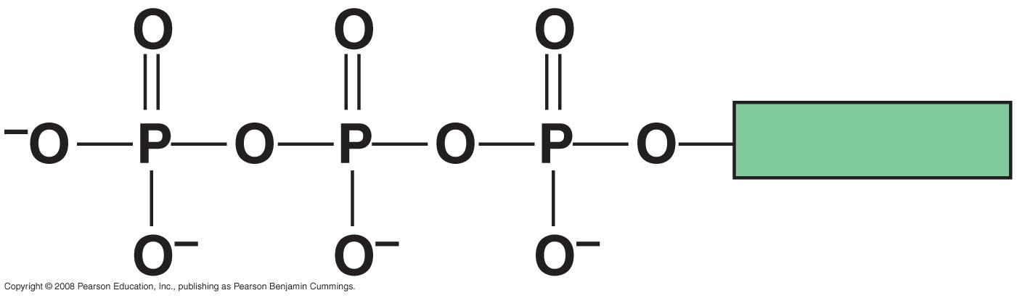
Fig. 4-UN3
Adenosine

Slide 34
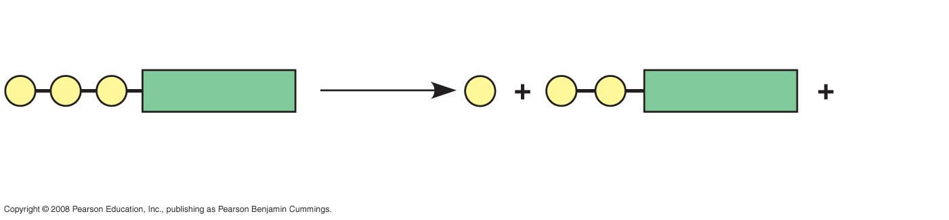
Fig. 4-UN4
Reacts with H₂O
P
P
P
Adenosine
P _{i}
P
P
Adenosine
Energy
ATP
Inorganic phosphate
ADP

Slide 35
The Chemical Elements of Life: A Review
The versatility of carbon makes possible the great diversity of organic molecules
Variation at the molecular level lies at the foundation of all biological diversity
Copyright © 2008 Pearson Education, Inc., publishing as Pearson Benjamin Cummings

Slide 36
Fig. 4-UN5
Reacts with H₂O
P
P
P
Adenosine
P _{i}
P
P
Adenosine
Energy
ATP
Inorganic phosphate
ADP

Slide 37
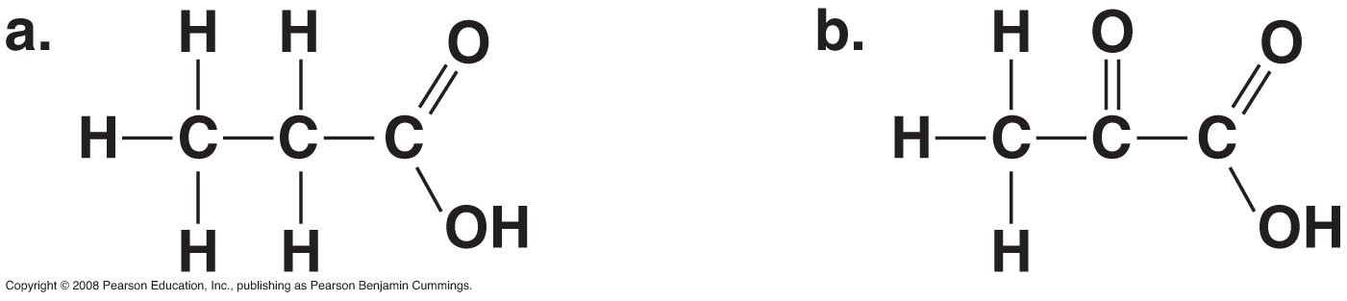
Fig. 4-UN2
Are these isomers?

Slide 38
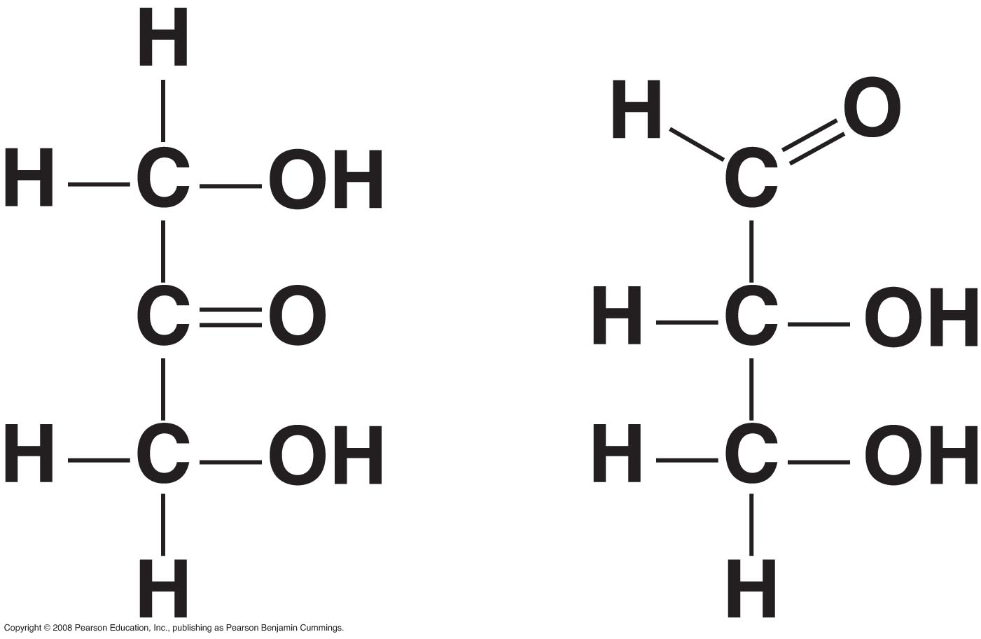
Fig. 4-UN6
Notes:
Are these isomers? What type? Structural.

Slide 39
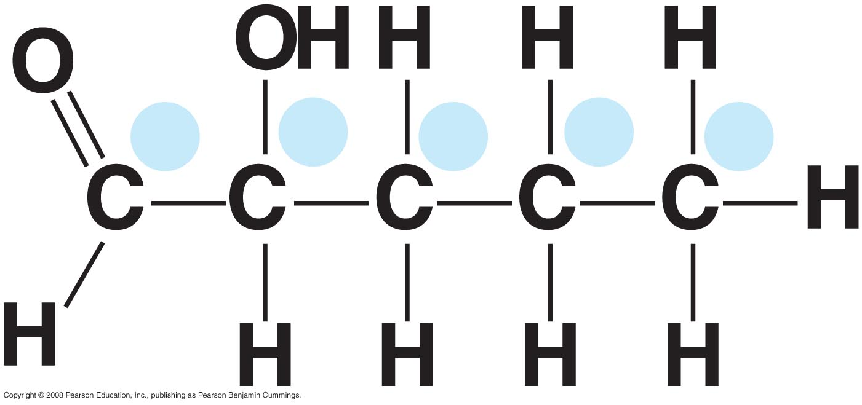
Fig. 4-UN7
a
b
c
d
e
Notes:
Which carbon is attached to a hydroxyl group? Which carbon is attached to a methyl group? Which carbon is part of a carbonyl ?

Slide 40
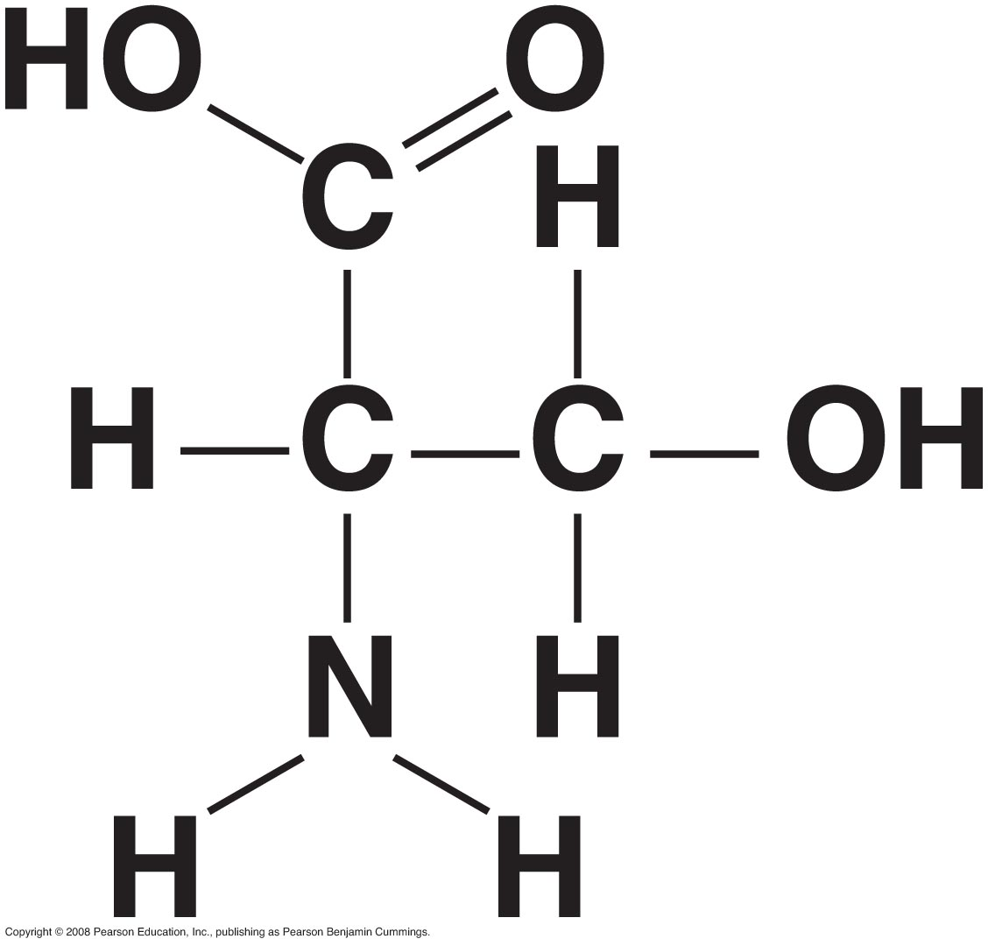
Fig. 4-UN8
Notes:
Carboxyl group on top . Amino group on bottom. Hydroxyl on right.

Slide 41
You should now be able to:
Explain how carbon’s electron configuration explains its ability to form large, complex, diverse organic molecules
Describe how carbon skeletons may vary and explain how this variation contributes to the diversity and complexity of organic molecules
Distinguish among the three types of isomers: structural, geometric, and enantiomer
Copyright © 2008 Pearson Education, Inc., publishing as Pearson Benjamin Cummings

Slide 42
Name the major functional groups found in organic molecules; describe the basic structure of each functional group and outline the chemical properties of the organic molecules in which they occur
Explain how ATP functions as the primary energy transfer molecule in living cells
Copyright © 2008 Pearson Education, Inc., publishing as Pearson Benjamin Cummings

